Slide 1

Review 2.2
B. Tech. Project (19ECE495)
Batch ID: 070
Mutual coupling reduction in MIMO Patch Antenna Array for Wi-Fi and Bluetooth applications
MENTOR: Ms. V. MEKALADEVI
Dept. of Elec. and Commn. Engg.
Amrita School of Engineering, Coimbatore
CB.EN.U4ECE22225 | - | J Rohith
CB.EN.U4ECE22262 | - | Peddakudala Yashwanth
CB.EN.U4ECE22213 | - | Chundupalle Tej Siddanth

Slide 2
OBJECTIVE:
•Design and analysis of base antenna at 2.4 GHz.
•Design and analysis of Patch antenna array at 2.4 GHz.
•Design and analysis of Patch antenna array with decoupling structures.
•Prototype and Measurement.
Performance Targets:
•Isolation: > 20 dB between antenna elements
•Element Spacing: < λ/2 for compact design
•Operating Frequency: 2.4 GHz (Wi-Fi and Bluetooth bands)

Slide 3
TIMELINE:
Review | Month | Milestone
1.1 | June-July 2025 | Literature Survey of Decoupling Structers.
1.2 | August – September 2025 | Design and Analysis of Base Antenna at 2.4 GHZ.
1.3 | October-November 2025 | Design and Analysis of Patch Antenna Array at 2.4 GHZ.
2.1 | December 2025-January 2026 | Design and Analysis of Patch Antenna Array with De-Coupling Structure at 2.4 GHZ.
2.2 | February-March 2026 | Prototype and Measurement

Slide 4
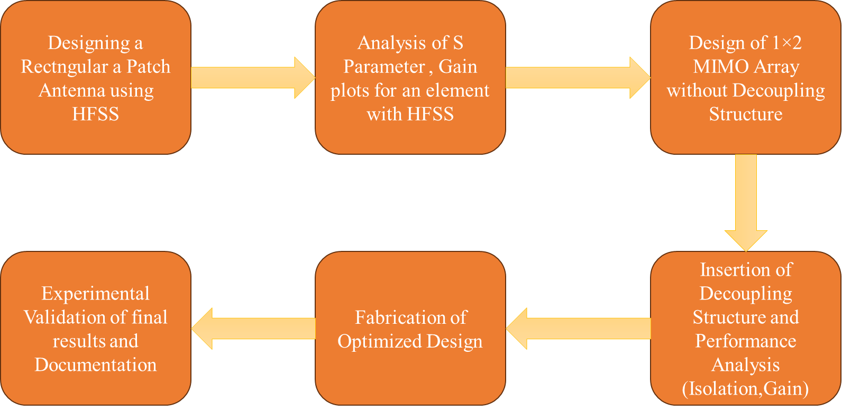
METHODOLOGY:

Slide 5
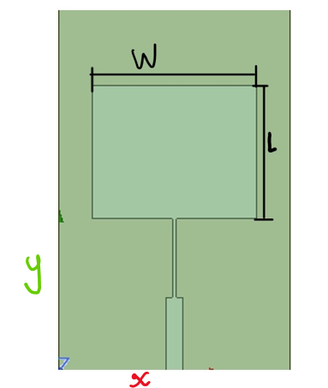
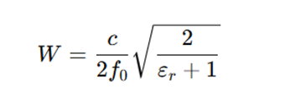
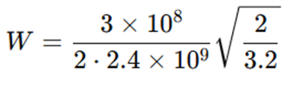
METHODOLOGY:
qPatch Antenna Dimension Calculation:
As the frequency of the application is 2.4 GHz, considering Rogers RT duroid 5880 (εr = 2.2) is a suitable substrate, the basic patch antenna dimensions are determined through mathematical calculations.
Designed for 2.4 GHz rectangular patch on Rogers RT duroid 5880(εr = 2.2) with h = 1.6 mm.
Patch Width(W):
…(1)
=> W = 45.38mm
Figure 1. Simulated model of a unit element of an Array

Slide 6

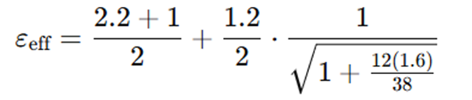

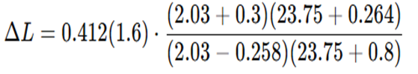
METHODOLOGY:
qPatch Antenna Dimension Calculation:
Effective Permittivity ε_{eff}
...(2)
=>εeff≈2.03
Fringing extension ΔL
...(3)
=> ΔL≈0.74mm

Slide 7



METHODOLOGY:
qPatch Antenna Dimension Calculation:
Effective length(L_{eff}):
...(4)
=> L_{eff} = 30.2mm
Physical length of patch:
...(5)
L = 39.7mm

Slide 8
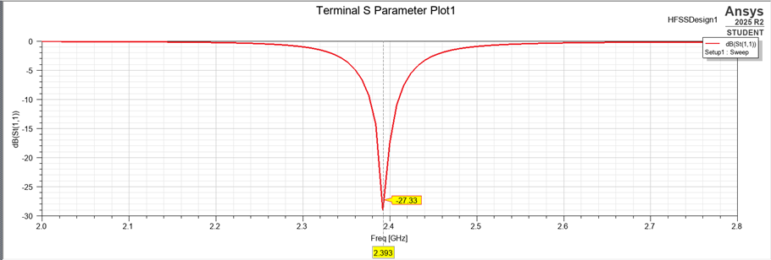
Results:
Analysis of the S-parameter plot for an element with HFSS.
Figure 2. Simulated S-parameter of a unit element

Slide 9
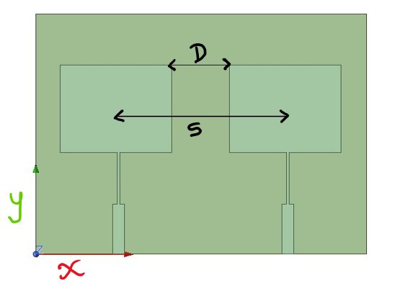
METHODOLOGY:
Design of 1×2 Patch antenna Array without Decoupling Structure:
The spacing between the centres of the two patches is chosen to be more than 0.5 λ₀ at 2.4 GHz.
This spacing is ideal because it helps the radiated waves from the two patches add constructively in the main lobe direction, enhancing the overall gain without creating unwanted grating lobes, also increasing isolation between the patches.
Variable | Value | Value In terms of λ₀
D(edge to edge) | 24.6 mm | 0.2 λ₀
S(centre to centre) | 71.4mm | 0.56 λ₀
Figure 3.1×2 Patch antenna Array
Table 1 : Spacing between the antennas

Slide 10
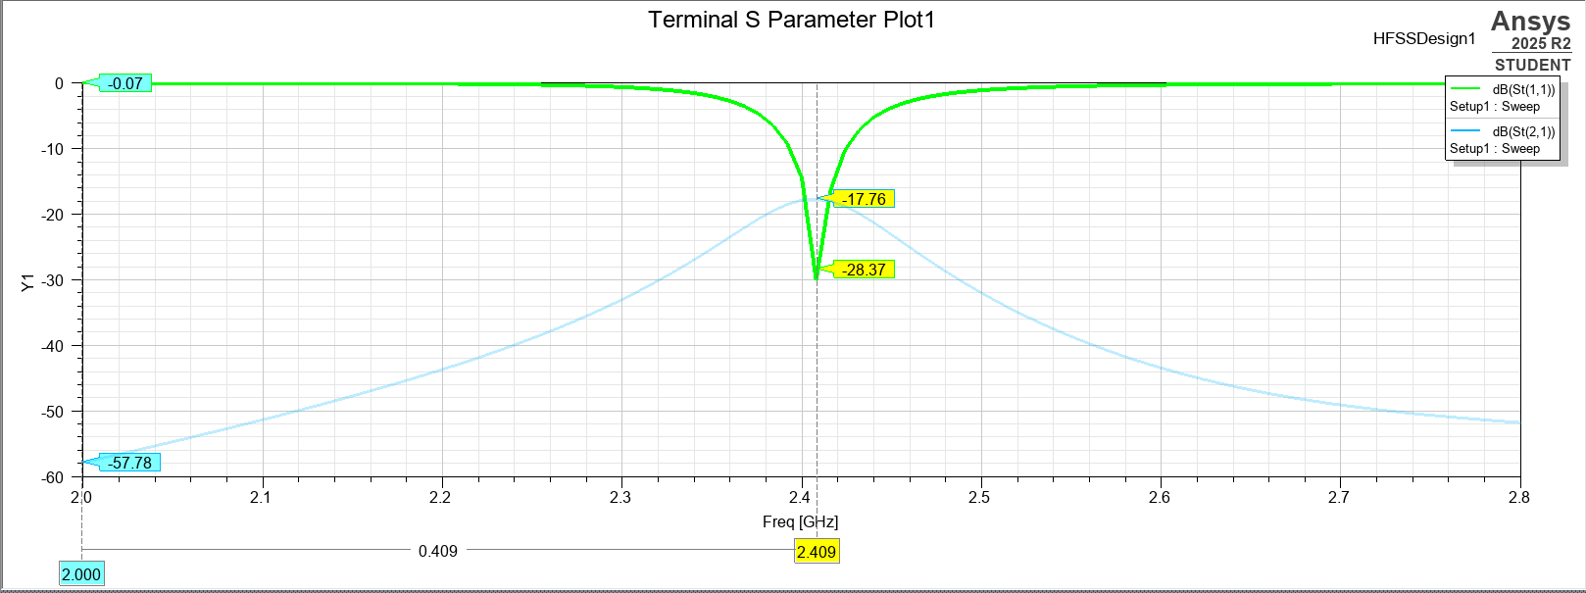
Results:
Analysis of the S-parameter plot for 1×2 Patch antenna Array without a Decoupling Structure with HFSS with centre to centre spacing as 0.56 λ₀.
Figure 4. Simulated S₁₁ of 1×2 Patch antenna Array

Slide 11
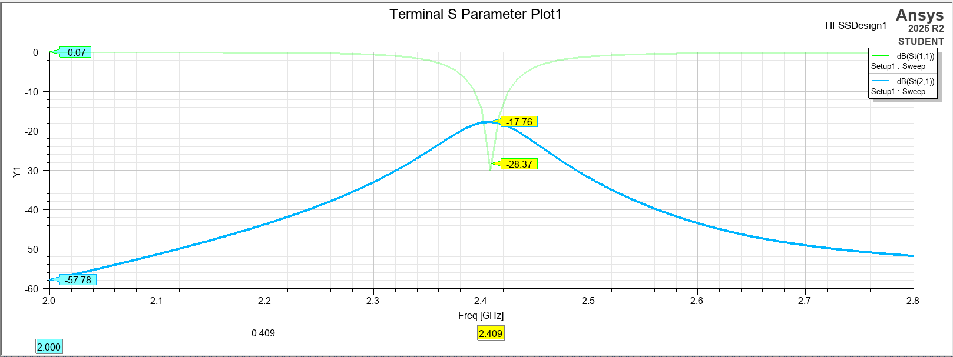
Results:
Analysis of the S-parameter plot for 1×2 Patch antenna Array without a Decoupling Structure with HFSS with centre to centre spacing as 0.56 λ₀.
Figure 5. Simulated S₂₁ of 1×2 Patch antenna Array

Slide 12
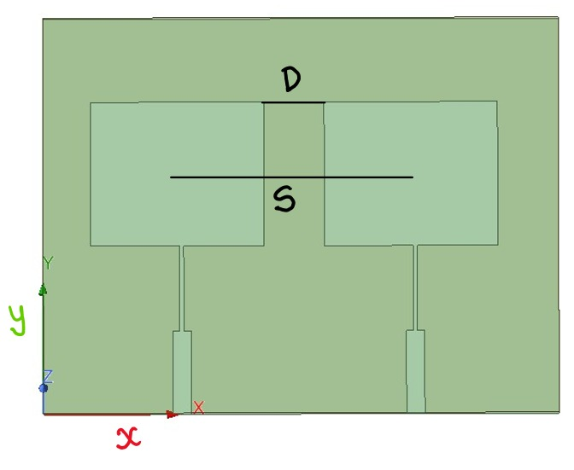
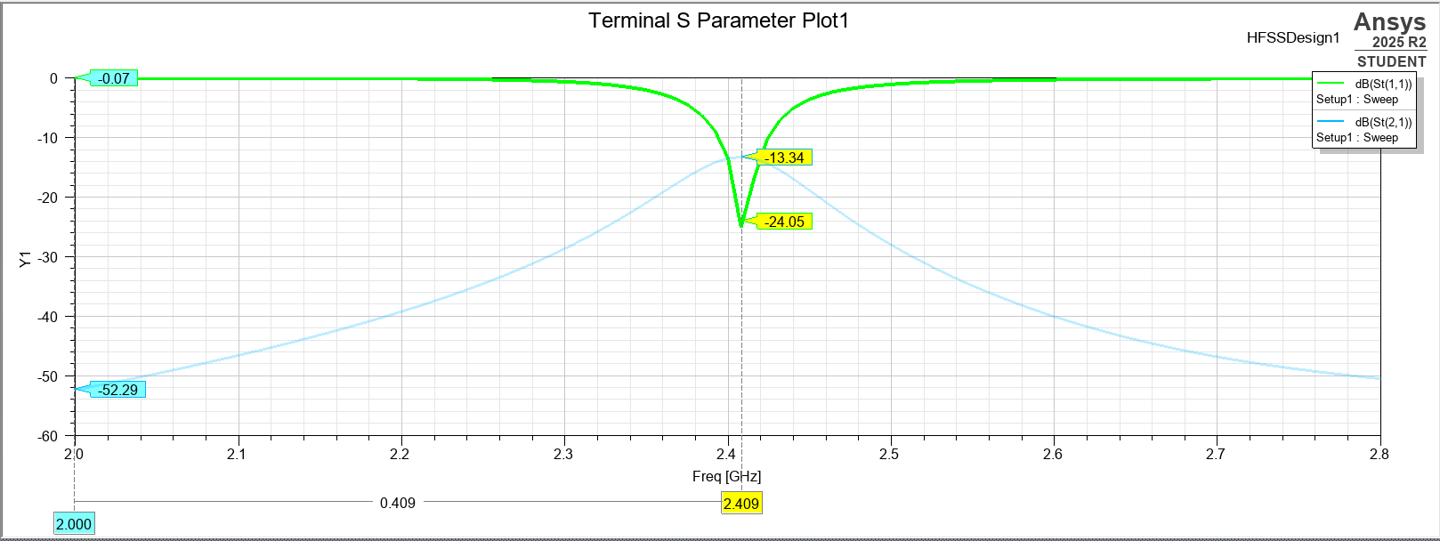
Results:
Analysis of the S-parameter plot for 1×2 Patch antenna Array without a Decoupling Structure with HFSS with centre to centre spacing as 0.5 λ₀.
Figure 6. Simulated S₁₁ of 1×2 Patch antenna Array
Figure 7.1×2 Patch antenna Array with centre to centre spacing of 0.5 λ₀.

Slide 13
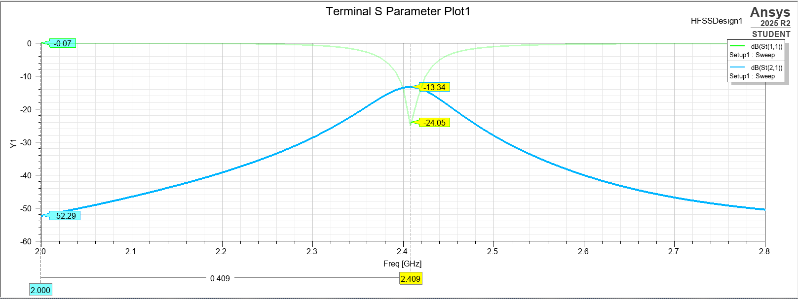
Results:
Analysis of the S-parameter plot for 1×2 Patch antenna Array without a Decoupling Structure with HFSS with centre to centre spacing as 0.5 λ₀.
Figure 8. Simulated S₂₁ of 1×2 Patch antenna Array
Variable | Value | Value In terms of λ₀
D(edge to edge) | 17.5 mm | 0.14 λ₀
S(centre to centre) | 62.5 mm | 0.5 λ₀
Table 2 : Spacing between the antennas

Slide 14
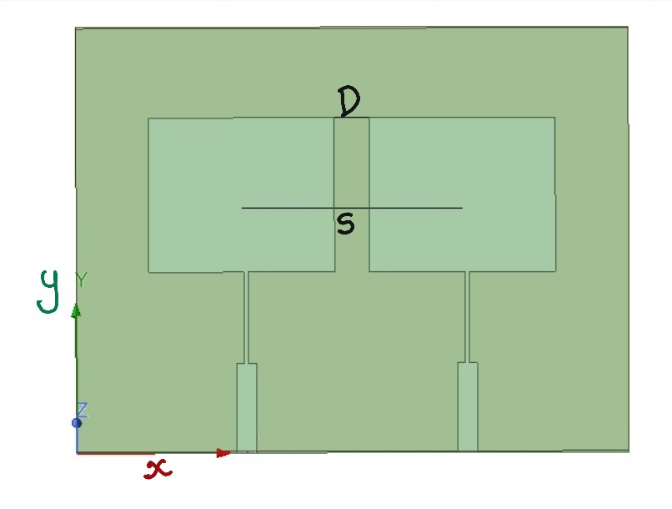
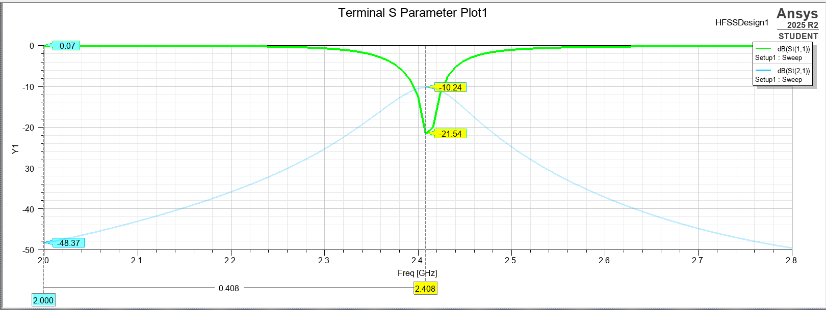
Results:
Analysis of the S-parameter plot for 1×2 Patch antenna Array without a Decoupling Structure with HFSS with centre to centre spacing as 0.45 λ₀.
Figure 8. Simulated S₁₁ of 1×2 Patch antenna Array
Figure 9.1×2 Patch antenna Array with centre to centre spacing of 0.45 λ₀.

Slide 15
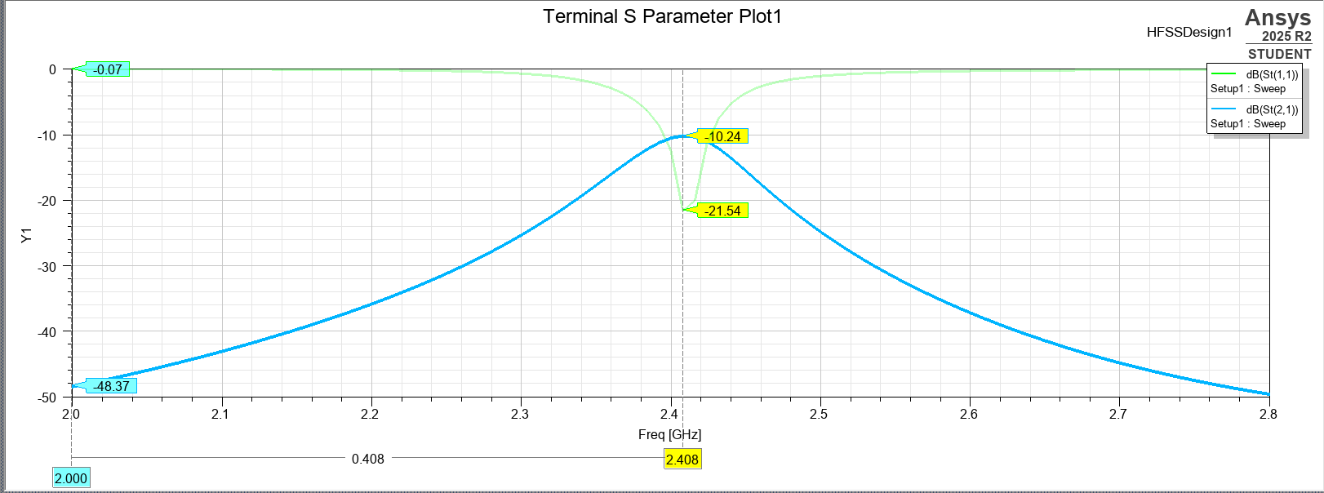
Results:
Analysis of the S-parameter plot for 1×2 Patch antenna Array without a Decoupling Structure with HFSS with centre to centre spacing as 0.45 λ₀.
Figure 10. Simulated S₂₁ of 1×2 Patch antenna Array
Variable | Value | Value In terms of λ₀
D(edge to edge) | 11.25 mm | 0.09 λ₀
S(centre to centre) | 56.25 mm | 0.45 λ₀
Table 3 : Spacing between the antennas

Slide 16
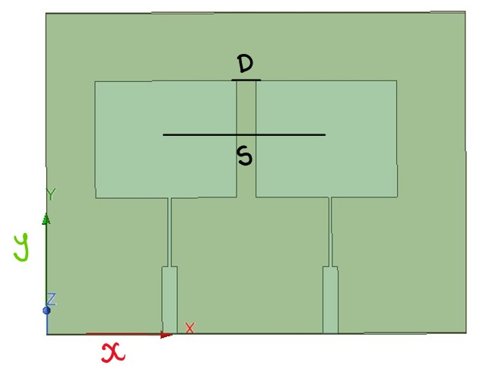
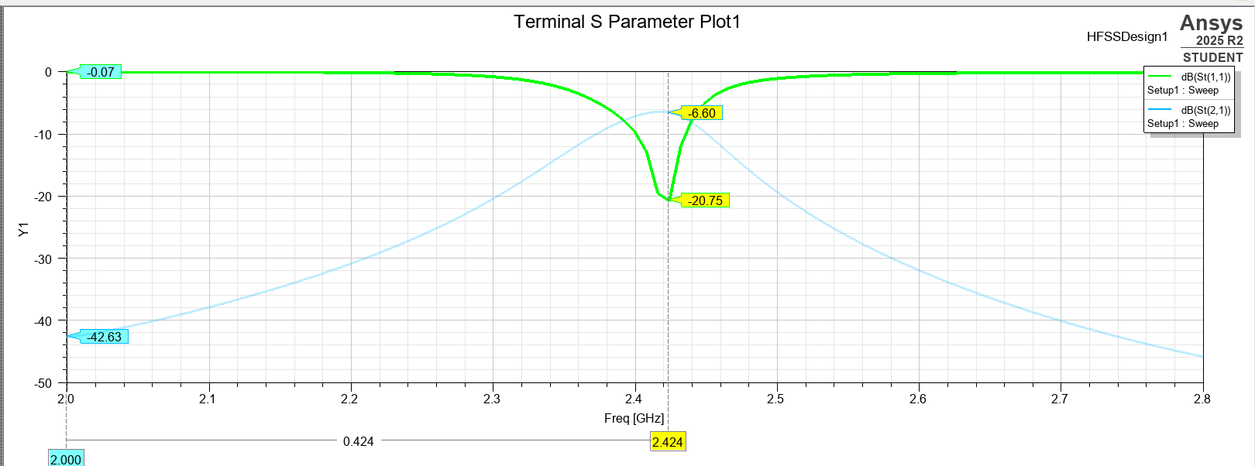
Results:
Analysis of the S-parameter plot for 1×2 Patch antenna Array without a Decoupling Structure with HFSS with centre to centre spacing as 0.4 λ₀.
Figure 11. Simulated S₁₁ of 1×2 Patch antenna Array
Figure 11.1×2 Patch antenna Array with centre-to-centre spacing as 0.4 λ₀.

Slide 17
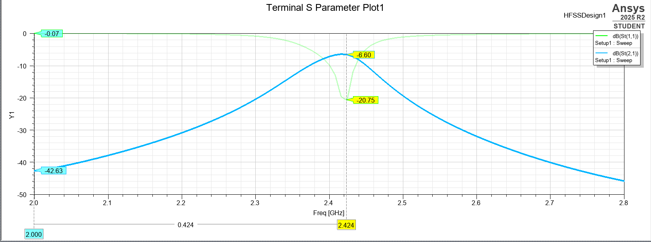
Results:
Analysis of the S-parameter plot for 1×2 Patch antenna Array without a Decoupling Structure with HFSS with centre to centre spacing as 0.4 λ₀.
Figure 12. Simulated S₂₁ of 1×2 Patch antenna Array
Variable | Value | Value In terms of λ₀
D(edge to edge) | 9.4 mm | 0.04 λ₀
S(centre to centre) | 50 mm | 0.4 λ₀
Table 4 : Spacing between the antennas

Slide 18
Results:
Value (centre to centre spacing between antennas)(in mm) | Value In terms of λ₀ (centre to centre spacing between antennas) | Corresponding S₂₁(in dB)
71.4 | 0.56 | 17.76
62.5 | 0.5 | 13.34
56.25 | 0.45 | 10.24
50 | 0.4 | 6.6
Table 5. S₂₁ for different antenna spacing

Slide 19
Method for Mutual Coupling Reduction :
Neutralisation line:
A neutralisation line is a metallic microstrip conductor or strip introduced between two antenna elements’ feed lines or radiators. It creates an artificial coupling path engineered to carry a current that is equal in magnitude but opposite in phase to the unwanted mutual coupling current between the elements. This leads to destructive interference, reducing the net coupled energy and improving isolation between ports.
Working: When two antennas are excited, their near fields and surface currents interact and induce a coupling current. The induced current in the NL has opposite phase to the naturally coupled current, thus cancelling it at the receiving port.

Slide 20
Design :
Length:
To produce a cancellation current with a suitable phase, the NL is usually designed to be near a half of wavelength at the operating frequency. This ensures that the current on the NL arrives at the adjacent port in roughly 180° phase difference relative to the directly coupled current.
Width :
Width affects the coupling strength — wider lines increase coupling but may disturb matching.

Slide 21
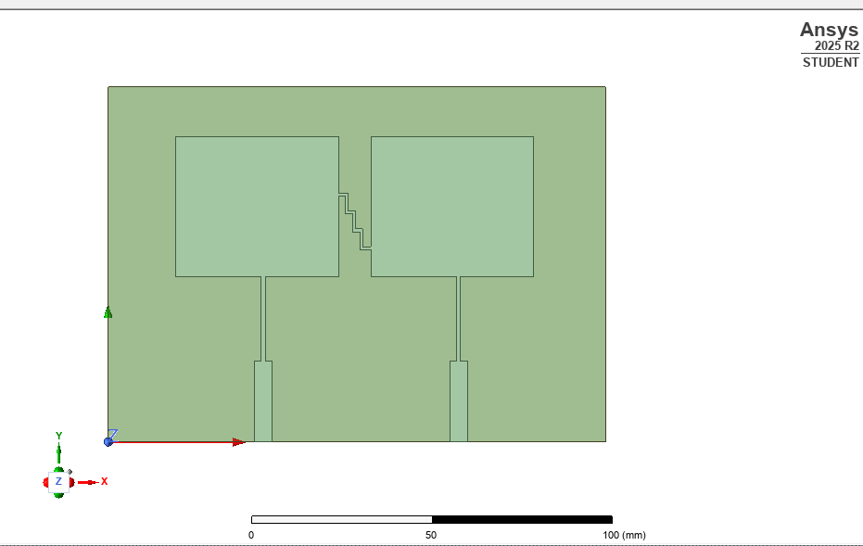
Design:
Figure 13. Design of 1×2 Patch antenna Array

Slide 22
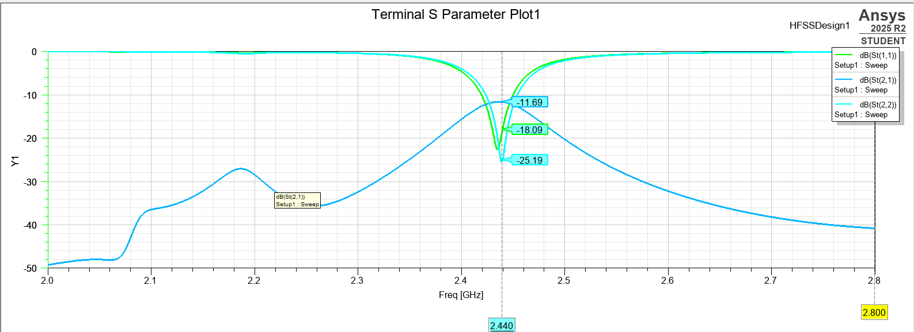
Results: Analysis of the S-parameter plot for 1×2 Patch antenna Array without a Decoupling Structure with HFSS with centre to centre spacing as 0.4 λ_{0 .}
Figure 14. Simulated S parameter of 1×2 Patch antenna Array

Slide 23
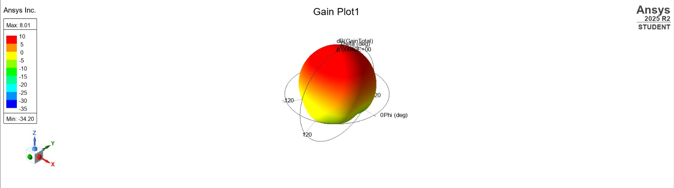
Results: Analysis of the Gain plot for 1×2 Patch antenna Array without a Decoupling Structure with HFSS with centre to centre spacing as 0.4 λ_{0 .}
Figure 15. Simulated Gain of 1×2 Patch antenna Array

Slide 24
Method for Mutual Coupling Reduction :
Parasitic Elements:
Coupling Cancellation Path: The length creates a specific electrical path that generates out-of-phase currents relative to the coupling currents between patches. This cancellation effect maximizes isolation at the design frequency.
Improved Isolation (S12/S21 Parameters) By strategically placing the parasitic element between the patches, better port-to-port isolation can be achieved, typically improving S12 parameters by 10-20 dB. This prevents signal interference between the two ports.

Slide 25
Design :
Parameters :
Free space wavelength: λ₀ =125mm
Length of the parasitic element = 47.5 mm =0.38λ₀
Width = 1.5mm
Reflector Mode Operation:
Creates isolation barrier between patch elements.
Width << Length Maintains patch antenna impedance stability.

Slide 26
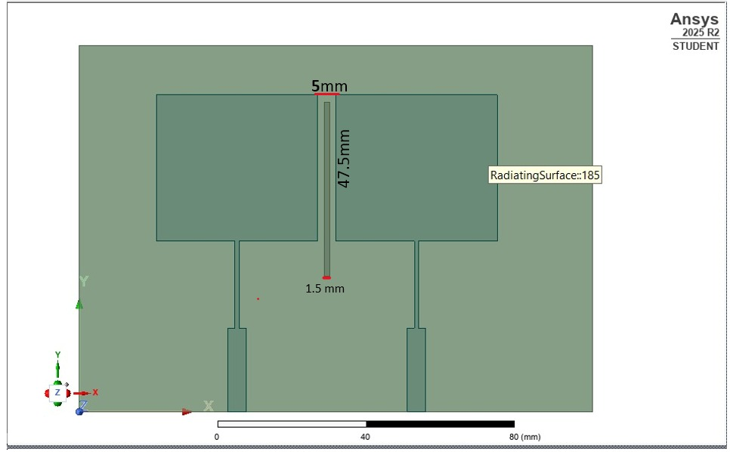
Design:
Figure 16. Design of 1×2 Patch antenna Array with parasitic element

Slide 27
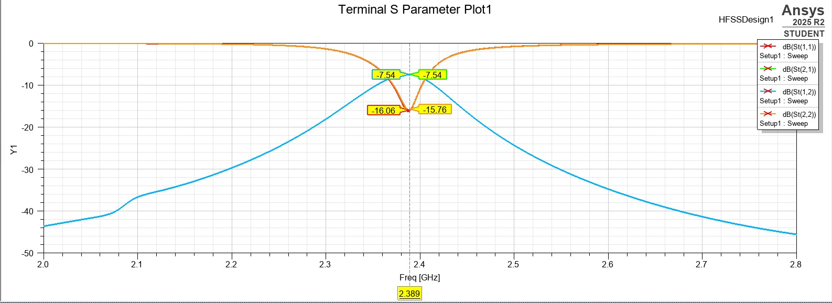
Results:
Figure 17 . Simulated S parameter of 1×2 Patch antenna Array without parasitic element

Slide 28
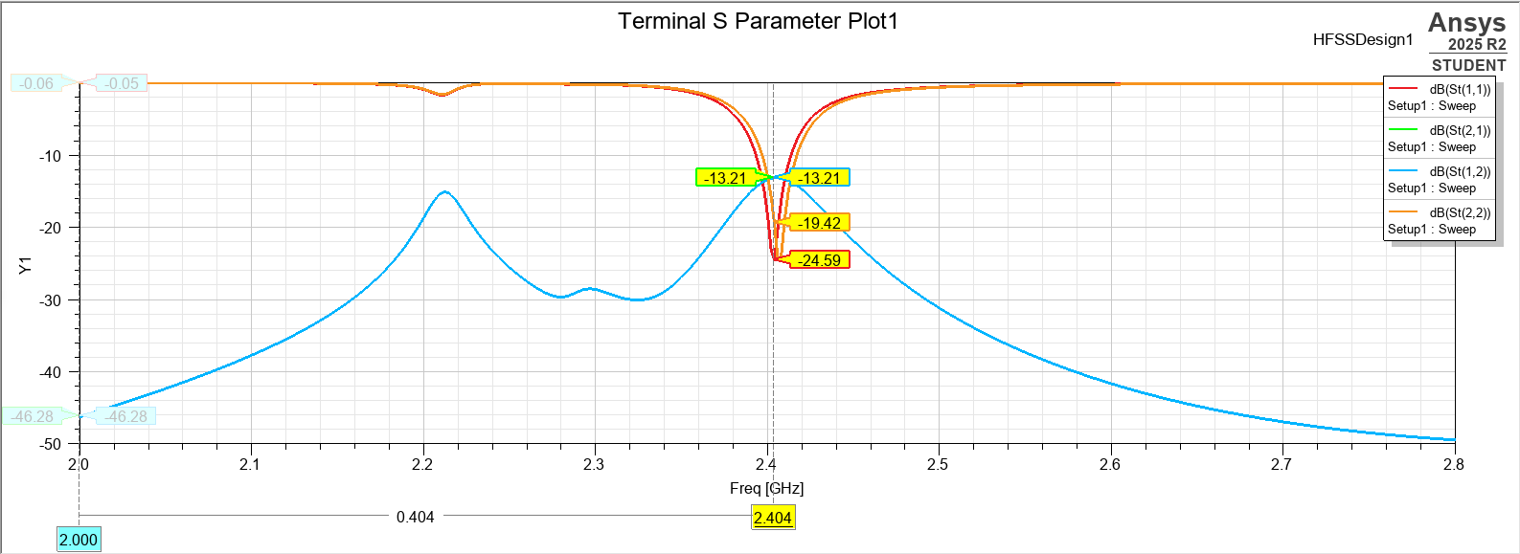
Results:
Figure 18 . Simulated S parameter of 1×2 Patch antenna Array with parasitic element

Slide 29
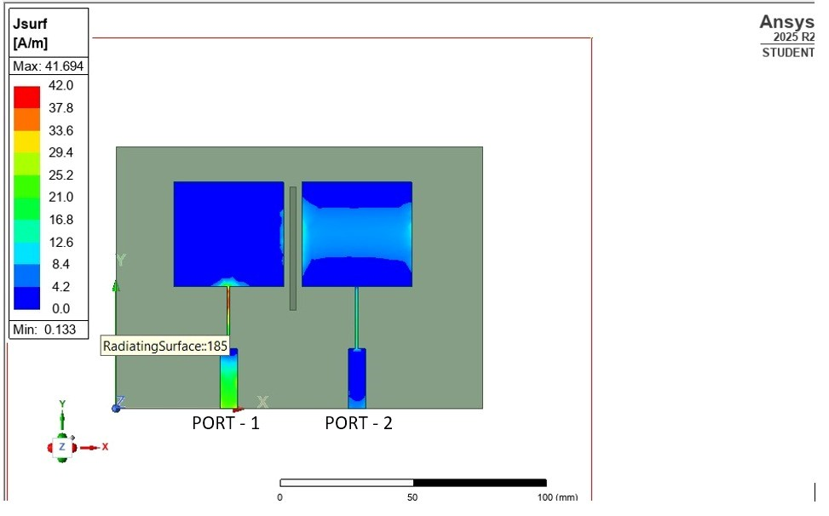
Results:
Figure 19. Surface current when port 1 is excited

Slide 30
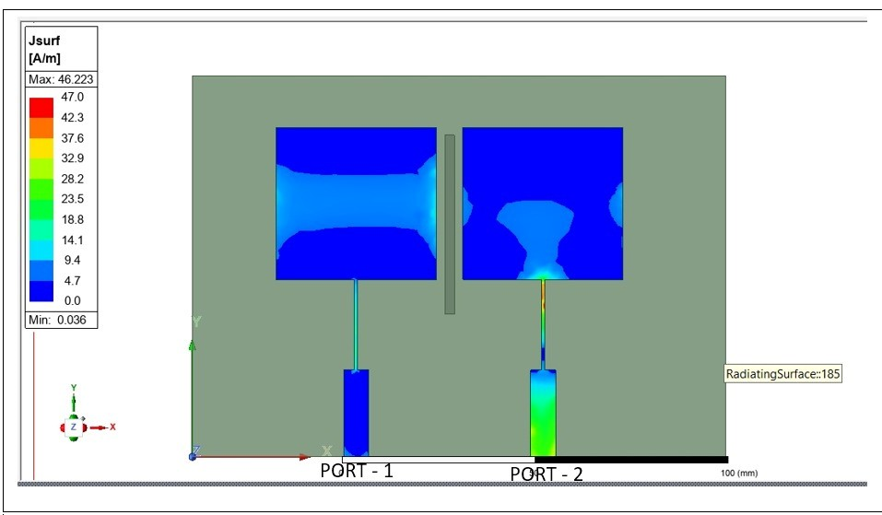
Results:
Figure 20. Surface current when port 2 is excited

Slide 31
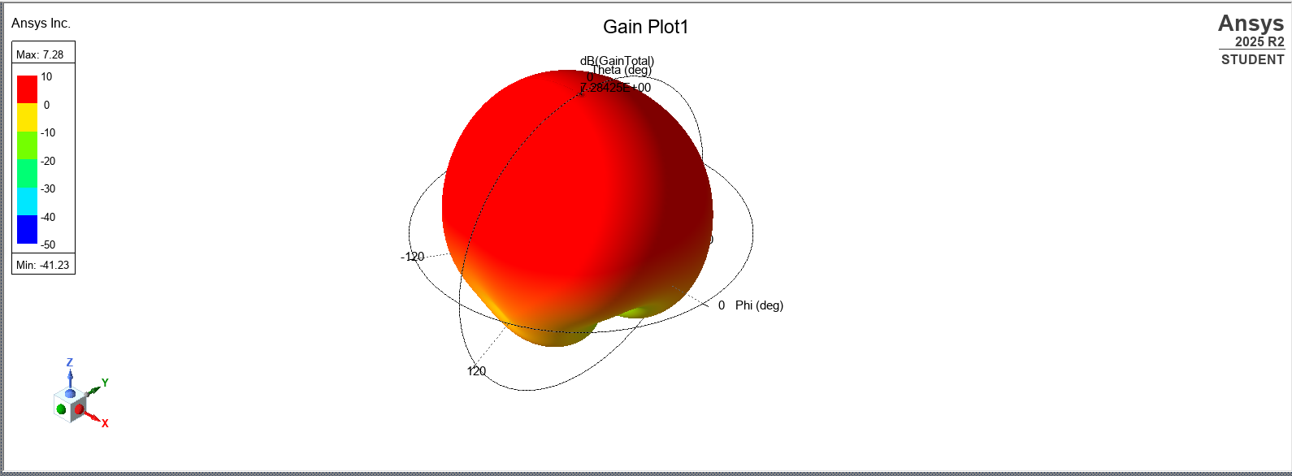
Results:
Figure 21. Simulated Gain of 1×2 Patch antenna Array

Slide 32
REFERENCES:
[1] S.ZhangandG.F.Pedersen, “Mutual coupling reduction for UWB MIMO antennas with a wideband neutralization line,” IEEE Antennas and Wireless Propagation Letters, vol.15, pp. 166–169,2016,doi: 10.1109/LAWP.2015.2438472.
[2] M. Li, Z. Xu, Y. Ban, C. Sim, and K. Kang,“Isolation enhancement of compact MIMO antennas using neutralization lines,”IEEE Transactions on Antennas and Propagation, vol. 67, no. 6, pp. 3850–3859, Jun. 2019,doi: 10.1109/TAP.2019.2903725.
[3] A. Li, S.-W. Qu, and S. Yang, “ Mutual Coupling Reduction of a Dual-Band Four-Port Patch Antenna With Co-Polarized Radiation Pattern by Controlling Electric Fields ,” IEEE Antennas Wireless Propag. Lett., vol. 21, no. 9, pp. 1762–1766, Sept. 2022, doi: 10.1109/LAWP.2022.3179404.
[4] Y. Yang, Y. Feng, L.-K. Zhang, Z. Xing, and J. Li, “ A Compact Multifrequency Broadband Dual-Antenna System With Mutual Coupling Reduction for Wi-Fi 6E Application ,” IEEE Antennas Wireless Propag. Lett., vol. 23, no. 12, pp. 4074–4078, Dec. 2024, doi: 10.1109/LAWP.2024.3428515.
[5] Z.-L. Su, K. W. Leung, and K. Lu, “Mutual Coupling Reduction in Dual-Band MIMO Antenna Using Parasitic Dollar-Shaped Structure for Modern Wireless Communication,” IEEE Trans. Antennas Propag., vol. 70, no. 9, pp. 7659–7669, Sept. 2023, doi: 10.1109/TAP.2023.3199567.

Slide 33
Thank You

